Slide 1
Plans and Progress on the USA-based Space Weather Socio-Economic Study
Terry Onsager and Doug Biesecker
NOAA Space Weather Prediction Center
Terry.Onsager@noaa.gov

Slide 2
Outline
• National mandate for study
• Study scope
• Work description
• Focus session at Space Weather Workshop
Improved understanding of economic impacts will guide future product develop and enhance the value of space weather services

Slide 3
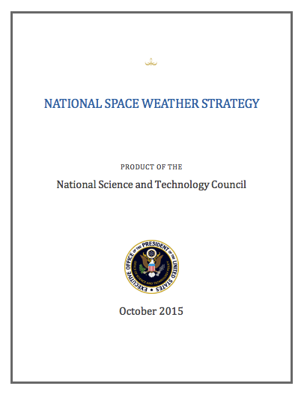
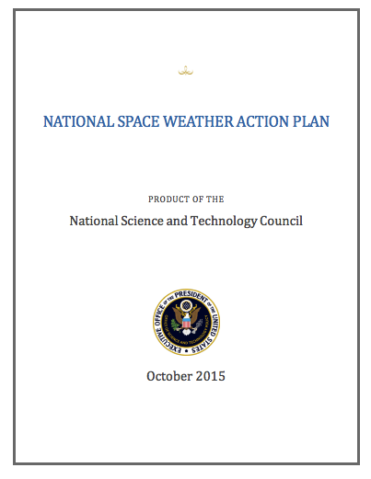
Space Weather Risks are Recognized - Economic Impact Assessment Required
U.S. National Strategy and Action Plan released October, 2015
Action 4.5.2: DOC, in coordination with DHS, will support research into the social and economic impacts of space-weather effects
Initiated: August, 2016
Completion: September, 2017
Study conducted by Abt Associates

Slide 4
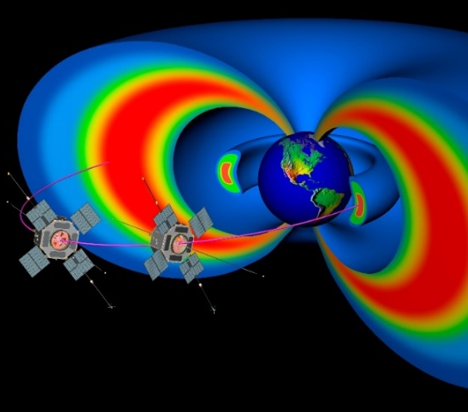
Study Scope
Identify, describe, and quantify the social and economic impacts of space weather to United States interests, including but not limited to:
• Damage or anticipated damage to the electric power system
• Lost productivity due to Global Navigation Satellite System impacts
• Impacts or anticipated impacts to aviation, including radiation
• Damage or anticipated damage to satellites

Slide 5
Work Description
• Quantify economic effects and other social effects, such as health
• Develop two sets of quantitative estimates:
- Theoretical maximum level event
- Moderate, more frequently occurring event
• Identify thresholds above which impacts can be expected
• Full documentation of methods, procedures, and recommended work

Slide 6
Space Weather Workshop Session on Economic Impact Modeling
• Encourage discussion of international economic impact modeling efforts
• Presentations on results and lessons learned
• Opportunity to consider follow-on work and possible collaborations
* See Mark Gibbs for additional information

